Slide 1
Ultimate Structural Case
Sample Presentation
Presentation Title [24 pt Arial Headings]
Name of Presenter [18 pt Arial Bolded]
Presenter’s Affiliation [18 pt Arial Regular]

Slide 2
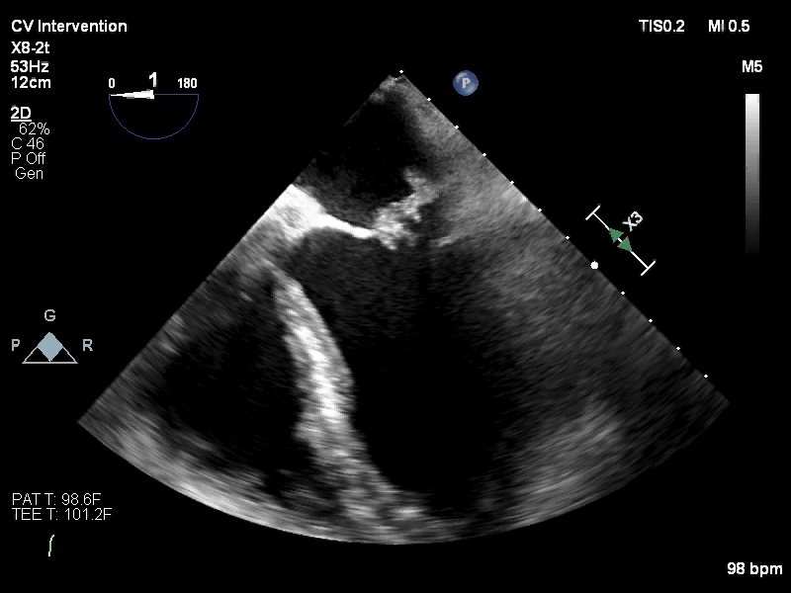
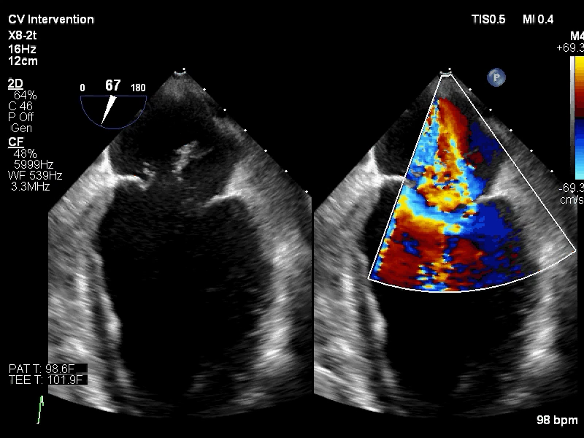
[angiogram, echo, CT/MRI, hemodynamics]
Imaging and diagnostic studies

Slide 3
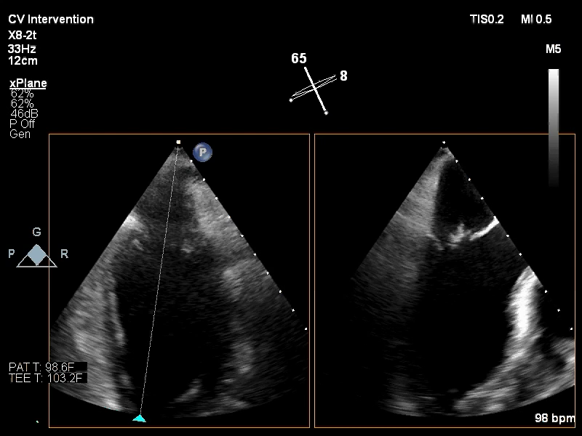
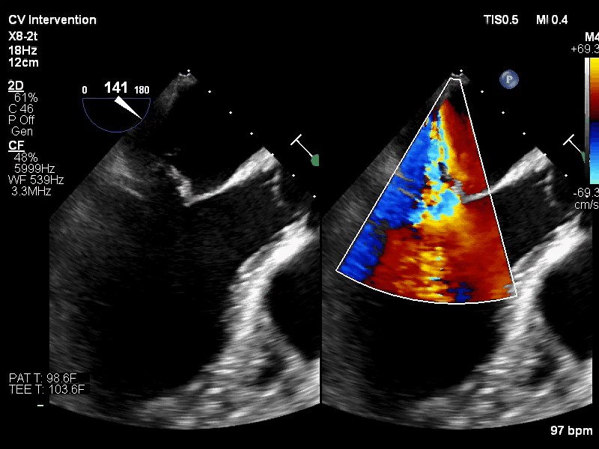
The Clinical Challenge
How to manage acute MR with papillary muscle with transcatheter therapy?

Slide 4
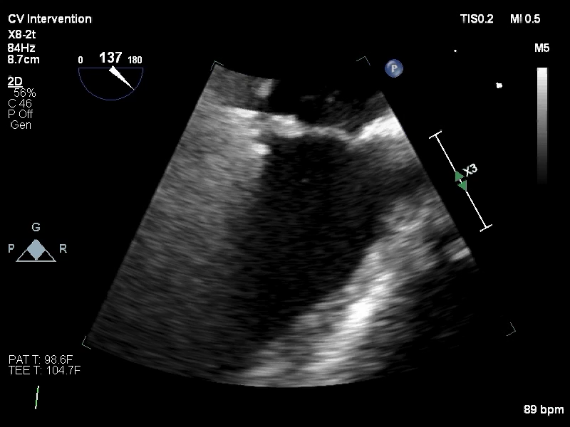
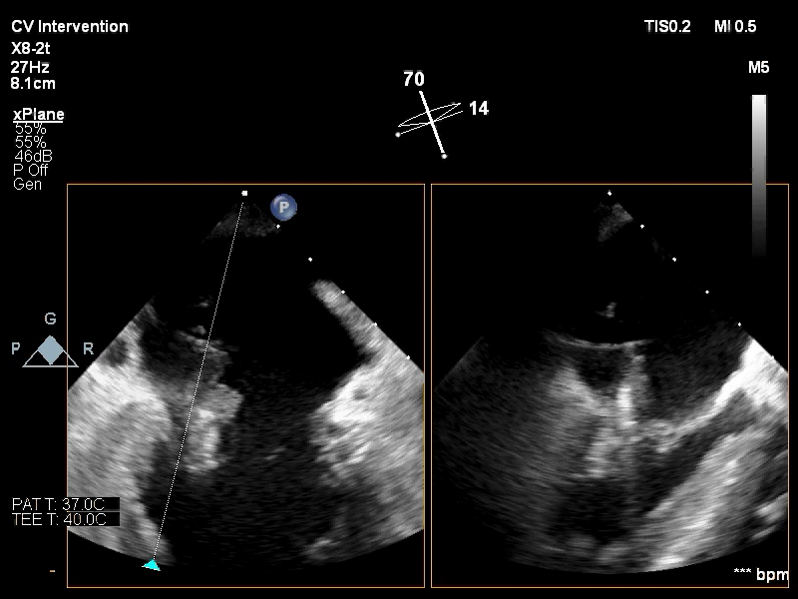
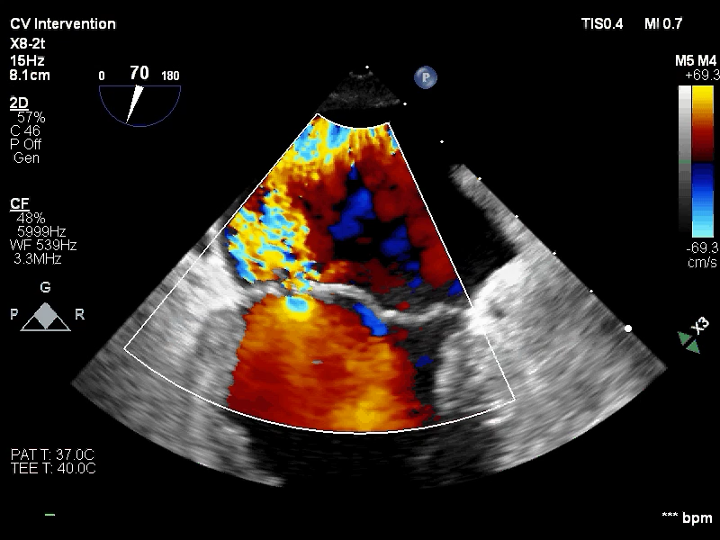
[show and state how the challenge was solved]
What Next?

Slide 5
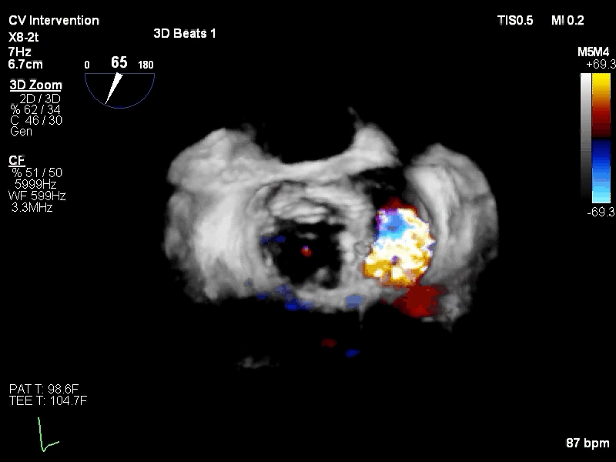
[show and state how the challenge was solved]
Resolution of the Challenge

Slide 6
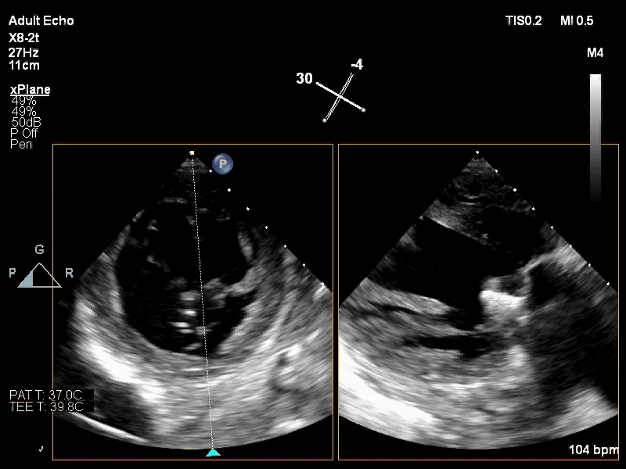
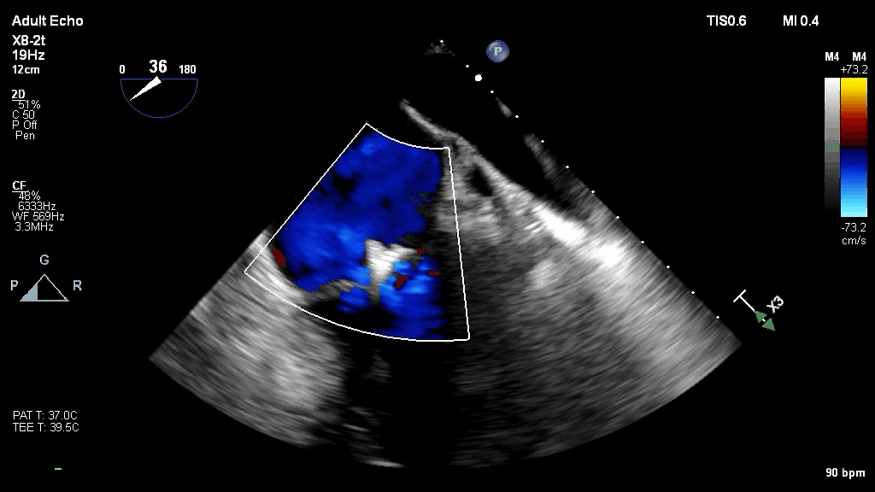
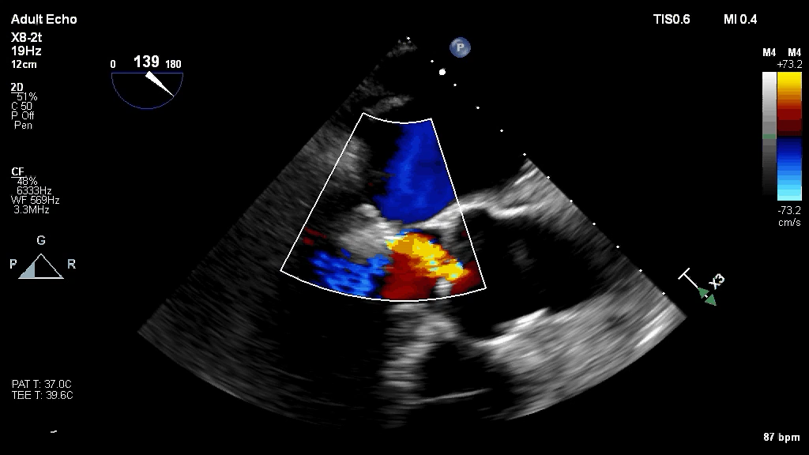
Different technique, better result
Trap papillary muscle in its anatomic position for better result

Slide 7
Key Learnings for the Operator and Team
Transcatheter Repair of Acute Papillary Muscle Rupture
Excessive gap height management often needed
Better outcome with trapping papillary muscle on LV side
Perfection not necessary – it’s usually a bridge to surgery
Use both LAP and MR for endpoints

