Slide 1
Ultimate Structural Case
Sample Presentation
Acute Complex Mitral Pathology
Paul Sorajja, MD
Allina Health Minneapolis Heart Institute Abbott Northwestern Hospital

Slide 2
Disclosures
All faculty disclosures for this program can be found at cvinnovations.org/cvi2025/cviaccred/.

Slide 3
Case Presentation
Reason for evaluation: 58 year-old man with inferior STEMI
Pertinent CV history:
Successful PCI with DES to RCA 6 hours ago
Persistent hypotension, on dopamine

Slide 4
Imaging and diagnostic studies

Slide 5
The Clinical Challenge
How to manage acute MR with papillary muscle with transcatheter therapy?

Slide 6
What next?

Slide 7
Emergent transcatheter repair
Resolution of the Challenge
What next?

Slide 8
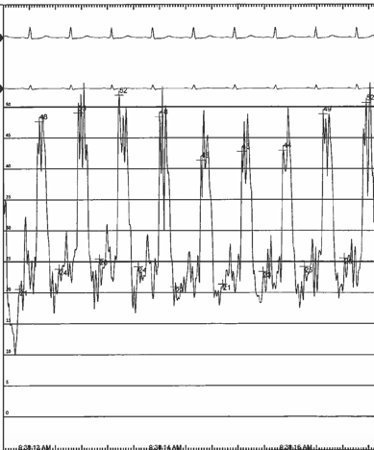
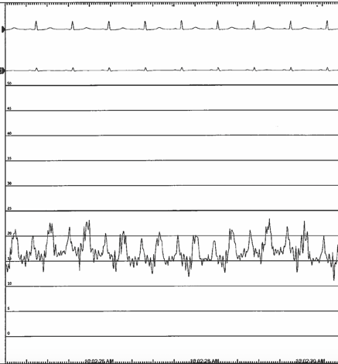
Left Atrial Pressure
42 mmHg
15 mmHg

Slide 9
Different technique, better result
Trap papillary muscle in its anatomic position for better result

Slide 10
Key Learnings for the Operator and Team
Transcatheter Repair of Acute Papillary Muscle Rupture
Excessive gap height management often needed
Better outcome with trapping papillary muscle on LV side
Perfection not necessary – it’s usually a bridge to surgery
Use both LAP and MR for endpoints

