Slide 1
Ultimate Structural Case
Acute Complex Mitral Pathology
Paul Sorajja, MD
Allina Health Minneapolis Heart Institute Abbott Northwestern Hospital
Sample Presentation

Slide 2
Disclosures
Consultant for 4C Medical, Abbott Structural, Edwards LifeSciences
Institutional grants from Medtronic, Boston Scientific
National P.I. for EXPAND II, SOAR EFS, SUMMIT MAC, TRILUMINATE, VDYNE

Slide 3
Case Presentation
Reason for evaluation: 58 year-old man with inferior STEMI
Pertinent CV history:
Successful PCI with DES to RCA 6 hours ago
Persistent hypotension, on dopamine

Slide 4
Imaging and diagnostic studies

Slide 5
How to manage acute MR with papillary muscle with transcatheter therapy?
The Clinical Challenge

Slide 6
What next?

Slide 7
Emergent transcatheter repair
Resolution of the Challenge
What next?

Slide 8
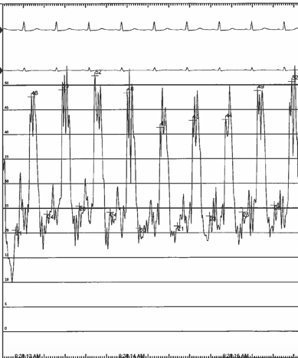
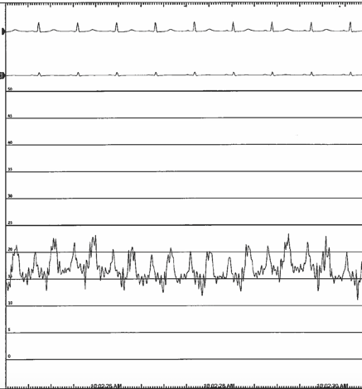
Left Atrial Pressure
42 mmHg
15 mmHg

Slide 9
Different technique, better result
Trap papillary muscle in its anatomic position for better result

Slide 10
Key Points for the Operator and Team
Transcatheter Repair of Acute Papillary Muscle Rupture
Excessive gap height management often needed
Better outcome with trapping papillary muscle on LV side
Perfection not necessary – it’s usually a bridge to surgery
Use both LAP and MR for endpoints

